Slide 1
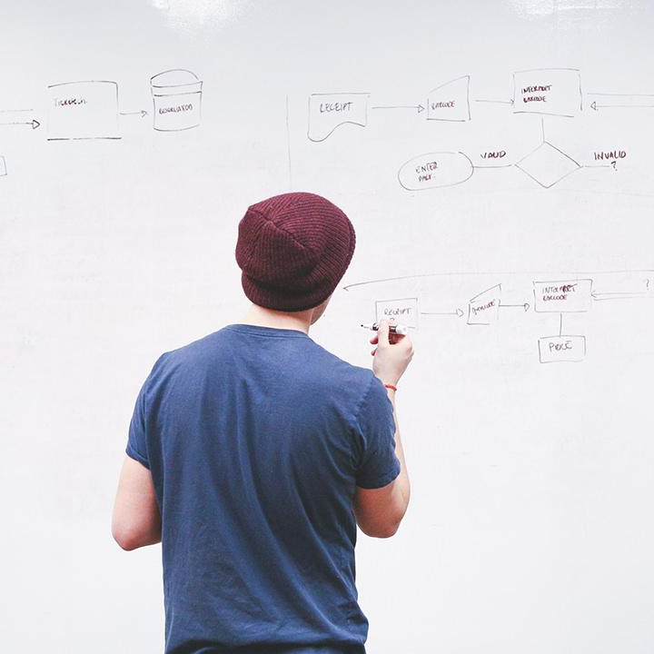
HELLO!
Here 1Crore Projects
I am here because I love to give presentations.
You can find me at @1CROREPROJECTS

Slide 2
A Proxy Re-Encryption Approach to Secure Data Sharing in the Internet of Things Based on Blockchain

Slide 3

AIM OF PROJECT
The aim of the project is proxy re-encryptionapproach to secure data sharing in cloud environments. Dataowners can outsource their encrypted data to the cloud using identity-based encryption, while proxy re-encryption constructionwill grant legitimate users access to the data.

Slide 4
ABSTRACT
The evolution of the Internet of Things has seen datasharing as one of its most useful applications in cloud computing.As eye-catching as this technology has been, data security remainsone of the obstacles it faces since the wrongful use of data leads toseveral damages. In this article, we propose a proxy re-encryptionapproach to secure data sharing in cloud environments. Dataowners can outsource their encrypted data to the cloud usingidentity-based encryption, while proxy re-encryption constructionwill grant legitimate users access to the data. With the Internet ofThings devices being resource-constrained, an edge device acts asa proxy server to handle intensive computations.

Slide 5
INTRODUCTION
Although simple, the traditional encryption schemes involvecomplex key management protocols and, hence, are not apt fordata sharing. Proxy re-encryption (PRE), a notion first proposedby Blaze et al. allows a proxy to transform a file computedunder a delegator’s public key into an encryption intended fora delegatee. Let the data owner be the delegator and the datauser be the delegate. In such a scheme, the data owner can sendencrypted messages to the user temporarily without revealing his secret key. The data owner or a trusted third party generatesthe re-encryption key. A proxy runs the re-encryption algorithmwith the key and revamps the ciphertext before sending the newciphertext to the user.

Slide 6
EXISTING SYSTEM
ABPRE allows a semi-trusted proxy to transform an encryption under an access-policy into an encryption under a new access policy, without revealing any information about the underlying message.
Healthcare is a multi-actor environment that requires independent actors to have a different view of the same data, hence leading to different access rights. Ciphertext Policy-Attribute-based Encryption (CP-ABE) provides a one-to-many access control mechanism by defining an attribute’s policy over ciphertext.

Slide 7
DISADVANTAGES
Compatibility Issues
Unblock Websites

Slide 8
PROPOSED SYSTEM
we propose a proxy re-encryption approach to secure data sharing in cloud environments. Data owners can outsource their encrypted data to the cloud using identity-based encryption, while proxy re-encryption constructionwill grant legitimate users access to the data.
With the Internet ofThings devices being resource-constrained, an edge device acts asa proxy server to handle intensive computations.

Slide 9
ADVANTAGES
No set up costs or complex system to operate
Provide a relatively long float

Slide 10
ALGORITHM
ABE
Attribute-based encryption (ABE) can be used for log encryption. Instead of encrypting each part of a log with the keys of all recipients, it is possible to encrypt the log only with attributes which match recipients' attributes.

Slide 11
Cipher Text
Cipher text is also known as encrypted or encoded information because it contains a form of the original plaintext that is unreadable by a human or computer without the proper cipher to decrypt it. Decryption, the inverse of encryption, is the process of turning cipher text into readable plaintext.

Slide 12
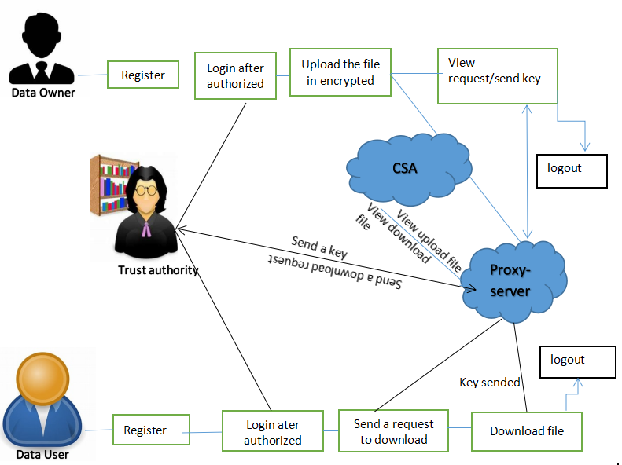
SYSTEM ARCHITECTURE

Slide 13
MODULES
In this project has four modules;
Data user
Trust authority
Data owner
proxy server
Cloud service provider

Slide 14
DATA OWNER
Register the account with the basic information
After authorize user can login the account with correct username and password
Upload the file with the encryption format.
View user request and Make a request for re-encryption
View the status and Re-Encrypted the key
Logout

Slide 15
TRUST AUTHORITY
TA can login the account with the correct Credentials
View users and owners authorize them
View user Download request and Send the Key
Logout

Slide 16
PROXY SERVER
Login the account with the correct username and password
View all uploaded files
View Re-Encryption request and Send the Responses
View all downloaded files
Graph
Logout

Slide 17
CLOUD SERVICE PROVIDER
Login the account with the correct username and password
View all uploaded files
View all downloaded files
Graph
Logout

Slide 18
HARDWARE REQUIREMENTS
System | Intel i3 and above
Hard Disk | 40GB
RAM | Minimum 4GB
Processor | 64-bit, four-core, 2.5 GHz minimum per core

Slide 19
FUTURE
In features of ICN to proficiently deliver cached content, thereby improving the quality of service and making great use of the network bandwidth. Then, we present a blockchain-based system model that allows for flexible authorization on encrypted data.

Slide 20
CONCLUSION
The emergence of the IoT has made data sharing one of its most prominent applications. To guarantee data confidentiality, integrity, and privacy, we propose a secure identity-based PRE data-sharing scheme in a cloud computing environment. Secure data sharing is realized with IBPRE technique, which allows the data owners to store their encrypted data in the cloud and share them with legitimate users efficiently. Due to resource constraints, an edge device serves as the proxy to handle the intensive computations. The scheme also incorporates the features of ICN to proficiently deliver cached content, thereby improving the quality of service and making great use of the network bandwidth.

Slide 21
REFERENCE
[1] A. Al-Fuqaha, M. Guizani, M. Mohammadi, M. Aledhari, and M. Ayyash,“Internet of Things: A survey on enabling technologies, protocols, andapplications,” IEEE Commun. Surveys Tut., vol. 17, no. 4, pp. 2347–2376,Oct./Dec. 2015.
[2] M. Blaze, G. Bleumer, and M. Strauss, “Divertible protocols and atomicproxy cryptography,” in Proc. Int. Conf. Theory Appl. CryptographicTechn., Springer, May 1998, pp. 127–144.
[3] A. Shamir, “Identity-based cryptosystems and signature schemes,” in Proc. Workshop Theory Appl. Cryptographic Techn., Springer, Aug. 1984,pp. 47–53.

Slide 22
[4] D. Boneh, G. Di Crescenzo, R. Ostrovsky, and G. Persiano, “Publickey encryption with keyword search,” in Proc. Int. Conf. Theory Appl.Cryptographic Techn., Springer, May 2004, pp. 506–522.
[5] B. R. Waters, D. Balfanz, G. Durfee, and D. K. Smetters, “Building anencrypted and searchable audit log,

Slide 23
THANKS
Any questions?
You can find me at
Reach us – 1croreprojects@gmail.com
Contact / Whatsapp: 7708 150 152 / 9751 800 789 / 790 432 0834

